Slide 2


Towards Financial Inclusion (FI)
Using survey data to assess FI status of the Philippines
Sprint 1, Sept 2022
Rick Aaron Sta.Clara
Notes:
Image: https://oi-files-cng-prod.s3.amazonaws.com/asia.oxfam.org/s3fs-public/styles/full-width-670x335-2_1/public/OGB_120684_Ruth,%20Davos%202020,%20Inequality.jpg?itok=Dm-D9WIN

Slide 3
SPRINT TIMELINE
 | MONDAY | TUESDAY | WEDNESDAY | THURSDAY | FRIDAY | SATURDAY
Week 1 | Sprint Overview Pandas: Basic data wrangling techniques | Pandas: Advanced data wrangling techniques | Data visualization Introduction to Streamlit | Lab activity: Exploratory Data Analysis | Data storytelling Creating your own Streamlit web page Mentor-free day | Review of Week 1
Week 2 | Introduction to Machine Learning Clustering | Introduction to Linear Regression and Logistic Regression Mentor-free day | Introduction to deployments Deployment using Streamlit Cloud and Hugging Face Spaces | Sprint Project Prep Day 1 | Sprint Project Prep Day 2 | Sprint Presentation

Slide 4
DAY 2 AGENDA
RECAP
01
ADVANCED PANDAS
02
APPROACHES TO DATA WRANGLING
03

Slide 5
01
RECAP

Slide 6
02
ADVANCED PANDAS

Slide 7
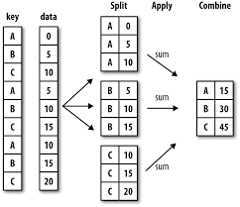
.groupby()
In pandas, to perform .groupby is essentially performing a chain of three steps:
Splitting the table intro groups.
Applying the operations to each of those smaller tables.
Combining the results.
This is very similar to the GROUP BY function of SQL.

Slide 8
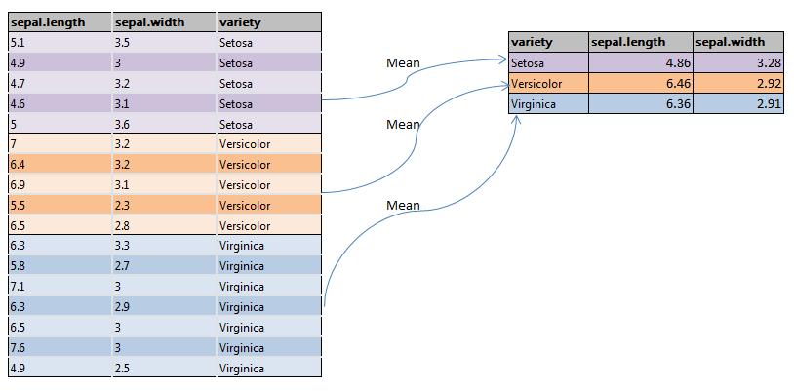
.groupby()

Slide 9
Combining tables
Usually, you might need to combine multiple tables to better understand your data. In pandas, there are 3 most common methods in combining dataframes:
By using pd.concat(). Used to append one or more dataframes on top of each other (“pagpapatong-patong”) or sideways (“pagtatabi-tabi”).
By using .join(). Used to merge two dataframes on the basis of their indices. If, say, your index is username (e.g. eskwe20221234), you can combine two tables (say, “transaction” and “profile” as long as they both have common identifier).
By using .merge(). Used to combine two or more dataframes on the basis of values of common columns (indices can also be used). This is a more general version of .join().
In merge,

Slide 10
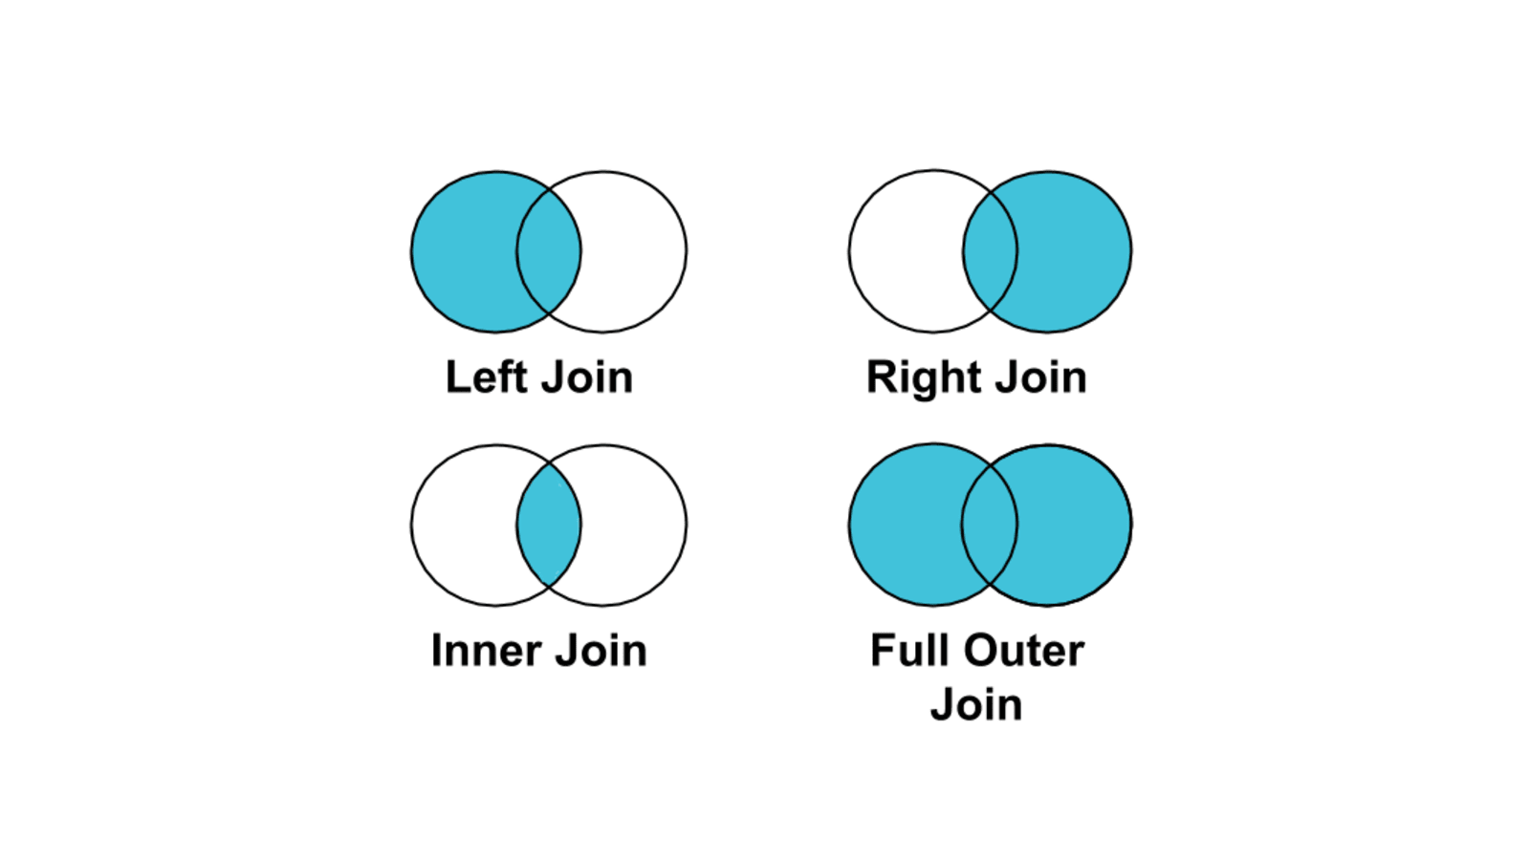
Overview of joins

Slide 11
Example of inner join
username | address | age
eskwe2 | Malabon City | 32
eskwe3 | Quezon City | 20
eskwe4 | Las Pinas City | 22
username | last transaction date | last transaction amount
eskwe2 | 2022-08-21 | 32
eskwe3 | 2022-09-01 | 20
username | address | age | last transaction date | last transaction amount
eskwe2 | Malabon City | 32 | 2022-08-21 | 32
eskwe3 | Quezon City | 20 | 2022-09-01 | 20

Slide 12
Example of left join
username | address | age
eskwe2 | Malabon City | 32
eskwe3 | Quezon City | 20
eskwe4 | Las Pinas City | 22
username | last transaction date | last transaction amount
eskwe2 | 2022-08-21 | 32
eskwe3 | 2022-09-01 | 20
username | address | age | last transaction date | last transaction amount
eskwe2 | Malabon City | 32 | 2022-08-21 | 32
eskwe3 | Quezon City | 20 | 2022-09-01 | 20
eskwe4 | Las Pinas City | 22 | None | None

Slide 13
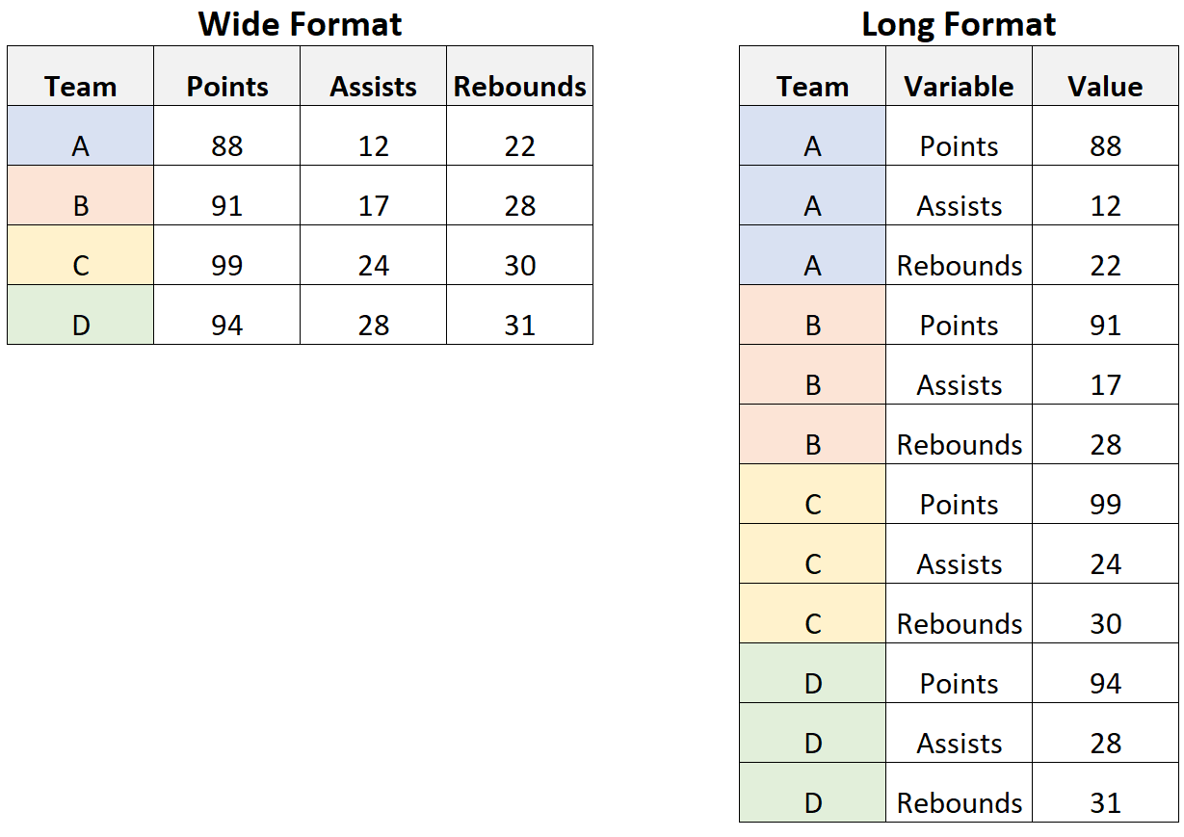
Reshaping the data
Sometimes we want to reshape the data for better interpretability. There are two common methods of reshaping: (1) converting long format to wide format and (2) converting wide format to long format.
In pandas, to convert long format to wide, we use pivot. Meanwhile, converting the reverse uses melt.

Slide 14
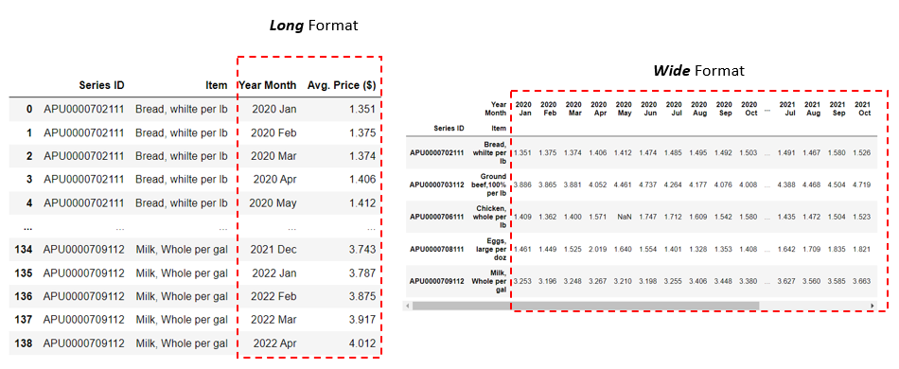
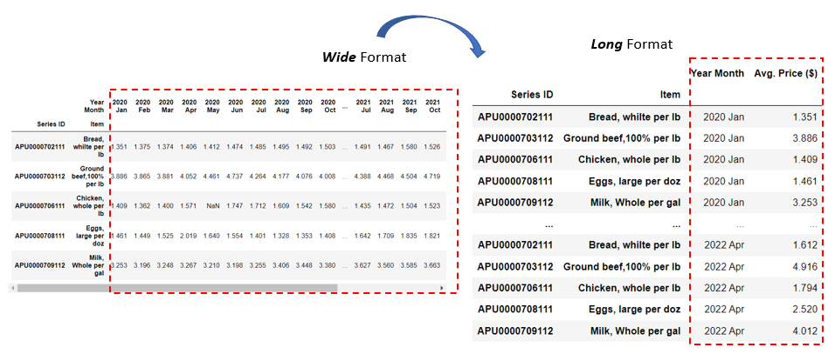
Use pd.pivot
Use pd.melt

Slide 15
LET’S CODE!
This is going to be a code-along session. If you can’t follow, feel free to open your mic and interrupt. You may also ask your mentors for help. Again, encountering errors is natural. 😁

Slide 16
ACTIVITY. In breakout rooms, load & explore the FI survey dataset (micro_world.csv). Try to do the following. Discuss findings with the rest of your group.
EASY. What is the breakdown of gender per region? Use .groupby().
AVERAGE. Per region, compute percentage of population with credit card AND debit card segmented by gender.
DIFFICULT. Compute the following metric per region:
card ownership access gender ratio = % of females with BOTH credit card AND debit card/% of males with BOTH credit card AND debit card
Allotted time: 20 minutes
Notes:
http://mathcenter.oxford.emory.edu/site/math117/shapeCenterAndSpread/

Slide 17
03
APPROACHES TO DATA WRANGLING

Slide 18
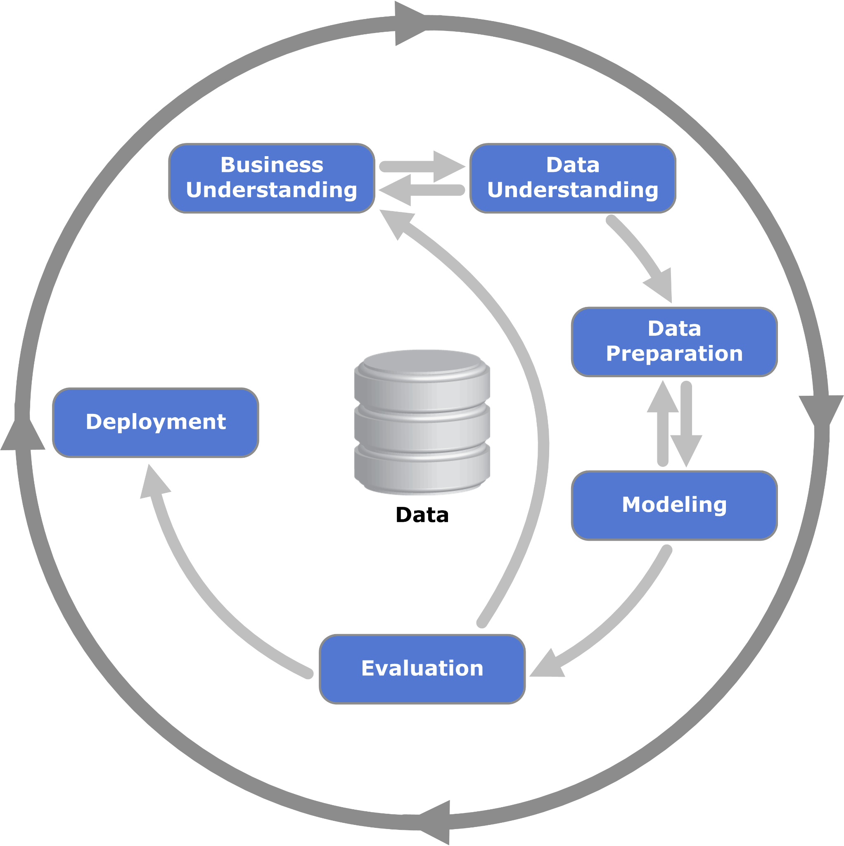
Before wrangling the data…
Always know the context of your data. What do you need the data for? How was it extracted? Is it timely (e.g. some data updates per second, per day, per week, etc)? Is it accurate?
Develop a hypothesis. Some people tend to start wrangling the data without a rough hypothesis in mind. Sometimes it works but without a rough hypothesis in mind, you will end up nowhere.
With a hypothesis in mind, develop a plan to wrangle the data. Outline the step you need to end up with the desired form of your table.

Slide 19
Thought Exercise 1
customer_id | transaction | transaction_date
1 | 1000 | 08/21/2022
1 | 1000 | 08/22/2022
3 | 2000 | 07/08/2022
3 | 2000 | 06/02/2022
2 | 3000 | 07/02/2022
2 | 3000 | 08/01/2022
2 | 3000 | 08/31/2022
?
month | total transaction amount
June 2022 | 2000
July 2022 | 5000
August 2022 | 8000

Slide 20
Thought Exercise 1
customer id | transaction amount | transaction date
1 | 1000 | 08/21/2022
1 | 1000 | 08/22/2022
3 | 2000 | 07/08/2022
3 | 2000 | 06/02/2022
2 | 3000 | 07/02/2022
2 | 3000 | 08/01/2022
2 | 3000 | 08/31/2022
?
month | total transaction amount
June 2022 | 2000
July 2022 | 5000
August 2022 | 8000
Possible solution:
Create another column for transaction month (derived from transaction date).
Group by transaction month and sum the transaction amount column.

Slide 21
Thought Exercise 2
respondent id | region | gender | income group | has debit card
4 | East Asia & Pacific | female | poorest 20% | 1
3 | Europe & Central Asia | male | middle 20% | 1
5 | South Asia | female | second 20% | 0
2 | Latin America & Carribean | male | richest 50% | 0
1 | Sub-Saharan Africa | female | fourth 50% | 1
... | ... | ... | ... | ...
region | gender | count
East Asia & Pacific | male | 500
 | female | 502
Europe & Central Asia | male | 5-17
 | female | 504
Latin America & Carribean | male | 502
 | female | 502
South Asia | male | 501
 | female | 502
Sub-Saharan Africa | male | 600
 | female | 400
?

Slide 22
Thought Exercise 2
respondent id | region | gender | income group | has debit card
4 | East Asia & Pacific | female | poorest 20% | 1
3 | Europe & Central Asia | male | middle 20% | 1
5 | South Asia | female | second 20% | 0
2 | Latin America & Carribean | male | richest 50% | 0
1 | Sub-Saharan Africa | female | fourth 50% | 1
... | ... | ... | ... | ...
region | gender | count
East Asia & Pacific | male | 500
 | female | 502
Europe & Central Asia | male | 5-17
 | female | 504
Latin America & Carribean | male | 502
 | female | 502
South Asia | male | 501
 | female | 502
Sub-Saharan Africa | male | 600
 | female | 400
?
Possible solution:
Group by region and gender and count.

Slide 23
Thought Exercise 3
income group | percent of males with debit card | percent of females with debit cards
poorest 20% | 42% | 43%
second 20% | 45% | 44%
middle 20% | 56% | 67%
fourth 20% | 89% | 45%
richest 20% | 87% | 23%
respondent id | gender | income group | has debit card
4 | female | poorest 20% | 1
3 | male | middle 20% | 1
5 | female | second 20% | 0
2 | male | richest 50% | 0
1 | female | fourth 50% | 1
... | ... | ... | ...
?

Slide 24
Thought Exercise 3
income group | percent of males with debit card | percent of females with debit cards
poorest 20% | 42% | 43%
second 20% | 45% | 44%
middle 20% | 56% | 67%
fourth 20% | 89% | 45%
richest 20% | 87% | 23%
respondent id | gender | income group | has debit card
4 | female | poorest 20% | 1
3 | male | middle 20% | 1
5 | female | second 20% | 0
2 | male | richest 50% | 0
1 | female | fourth 50% | 1
... | ... | ... | ...
?
Possible solution:
Group by income group and gender then (i) count and (ii) sum of has_debit_card.
Divide (ii) by (i).
Pivot the data.

Slide 25
TAKE-HOME READING:
What Great Data Analysts Do — and Why Every Organization Needs Them
by Cassie Kozyrkov
Ask:
How do you differentiate analytics, statistics and machine learning?
What’s the role of analytics in decision-making?
What makes analysts so important in the age of data science and machine learning hype?
Notes:
http://mathcenter.oxford.emory.edu/site/math117/shapeCenterAndSpread/

Slide 26
End of Sprint 1 Day 2
Any questions?

